Slide 1
CRICINFO
BY :
Shreedharagowda B P
Paarthasaarathi A
Prasanth S
Debayan
Devansh

Slide 2
1. Problem Statement
Users want to see new matches, up-coming-matches and old-matches.
Also Users can Recommend New-Matches, and Recommended Match will be Favorite Match for Who Recommended the Match.

Slide 3
1.1 Objective
To provide information about Old Matches, New Matches and Upcoming Matches.
This will allow user to add matches to his favorite list and also allow to recommend matches to other users.
This application also allows to search matches.

Slide 4
2. Technology And Tools
Technologies
Backend
Spring Boot With Hibernate.
Mongodb, MySql.
Frontend
HTML 5, CSS 3, Bootstrap 4
Angular 8.
Tools
Spring Tool Suite-4-4.7.0.
Visual Studio Code, MySql workbench, Mongo compass.

Slide 5
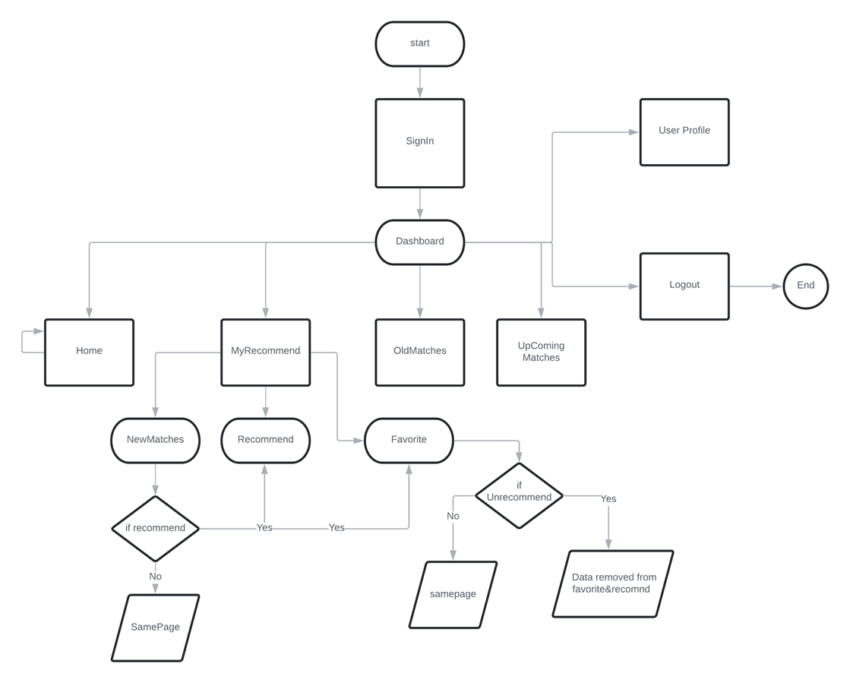
Flow Chart

Slide 6
Modules
Register
Login
New Matches
Old Matches
Upcoming Matches
Recommended Matches
Favorite Matches
Update profile

Slide 7
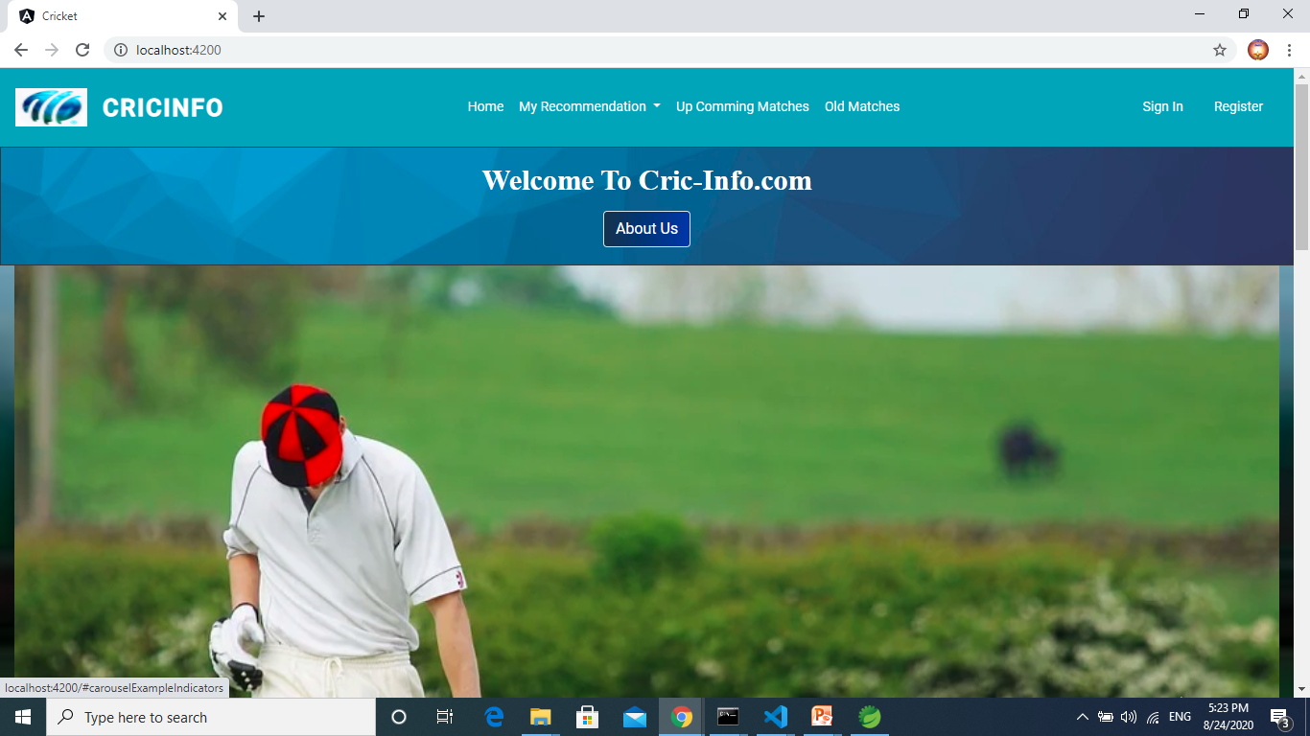
CrickInfo - Home

Slide 8
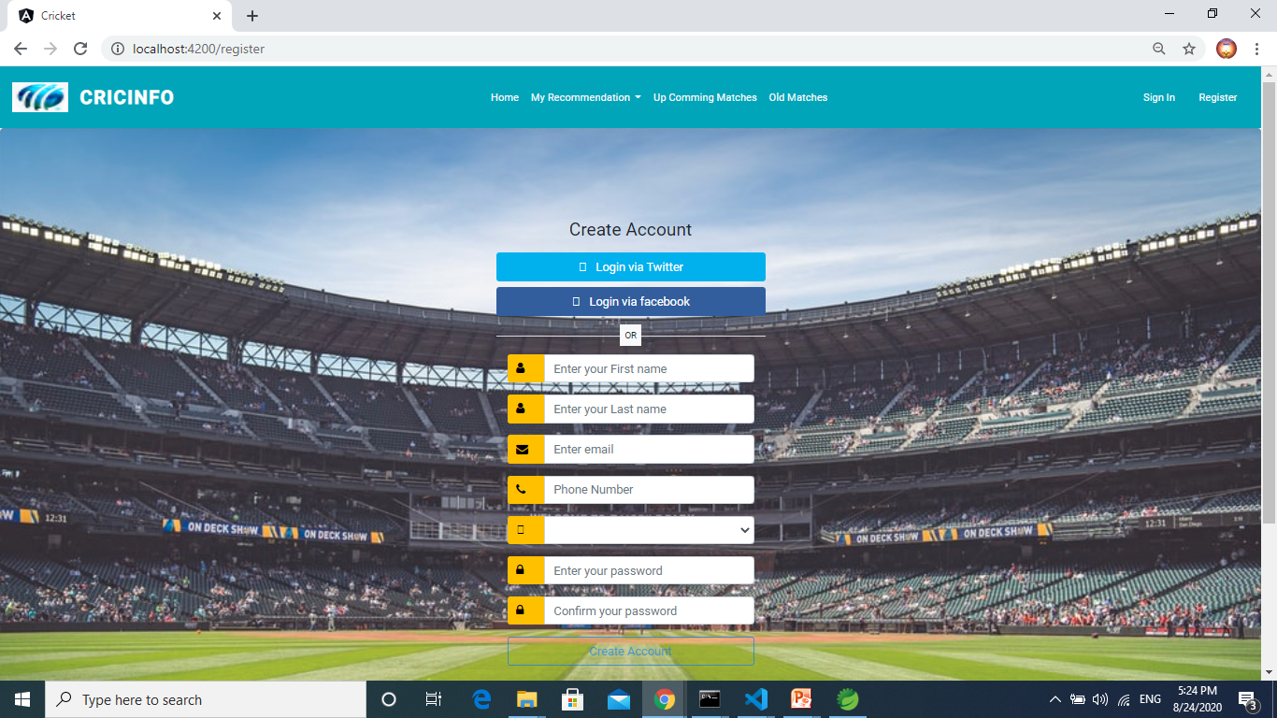
Register

Slide 9
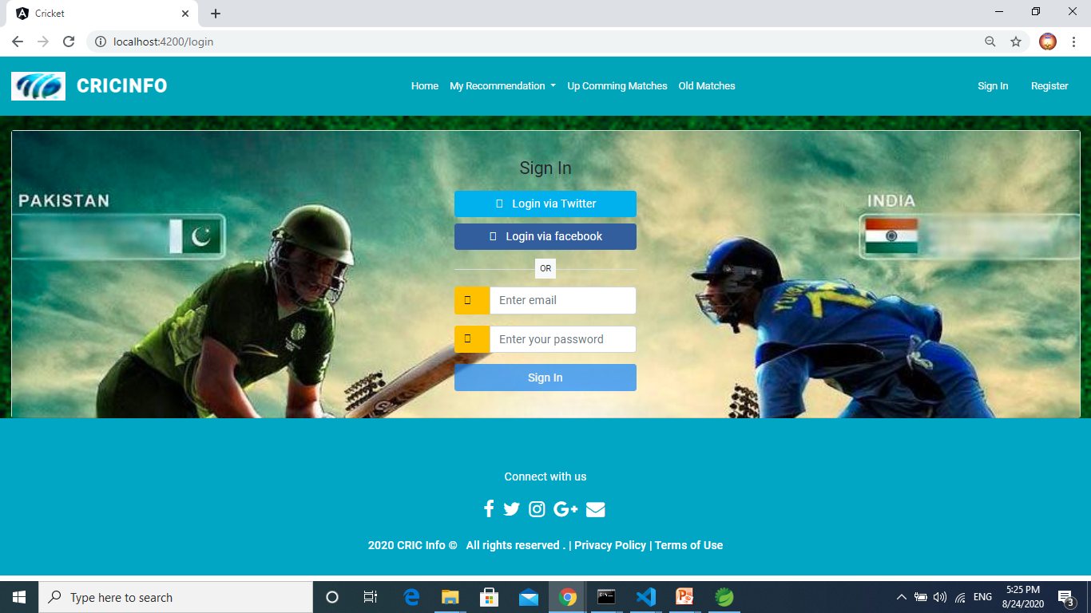
Login

Slide 10
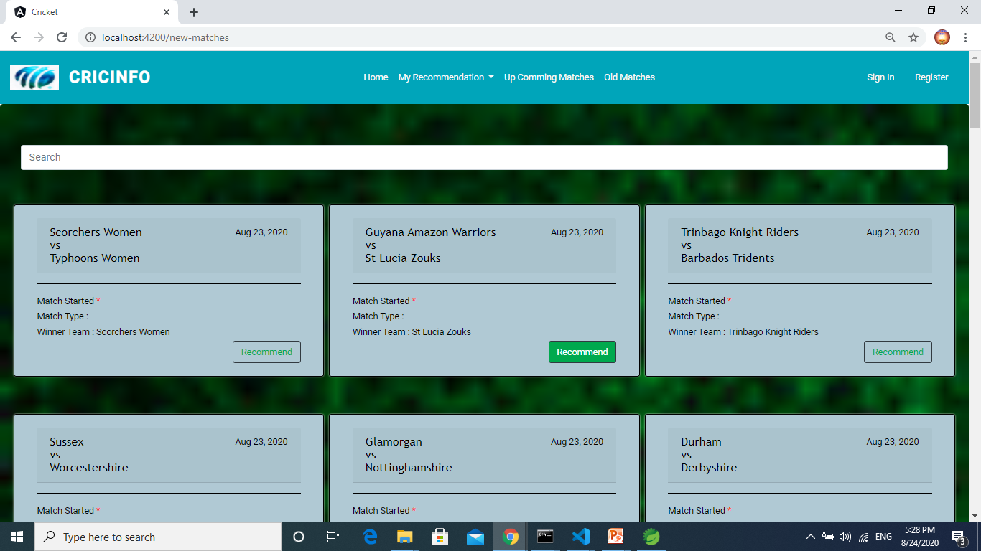
New-Matches

Slide 11
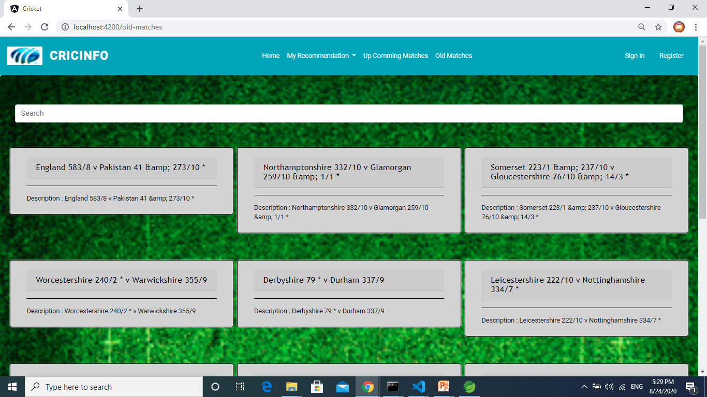
Old-Matches

Slide 12
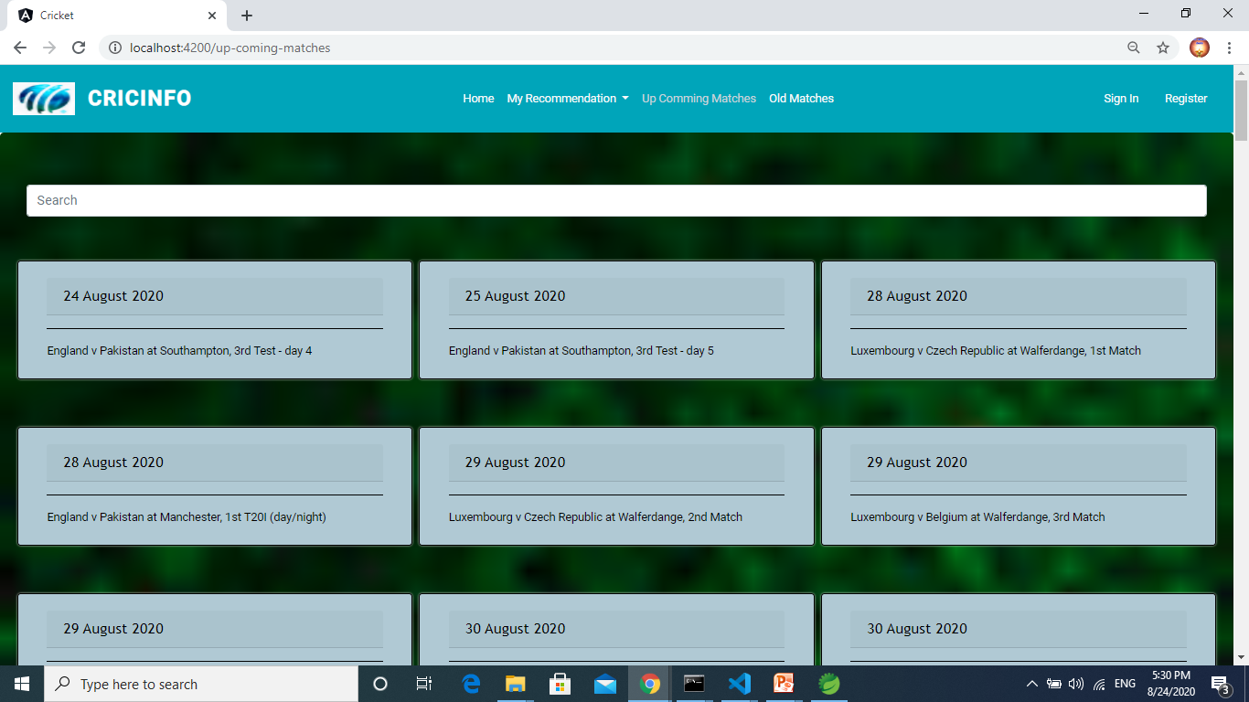
Up-Coming-Matches

Slide 13
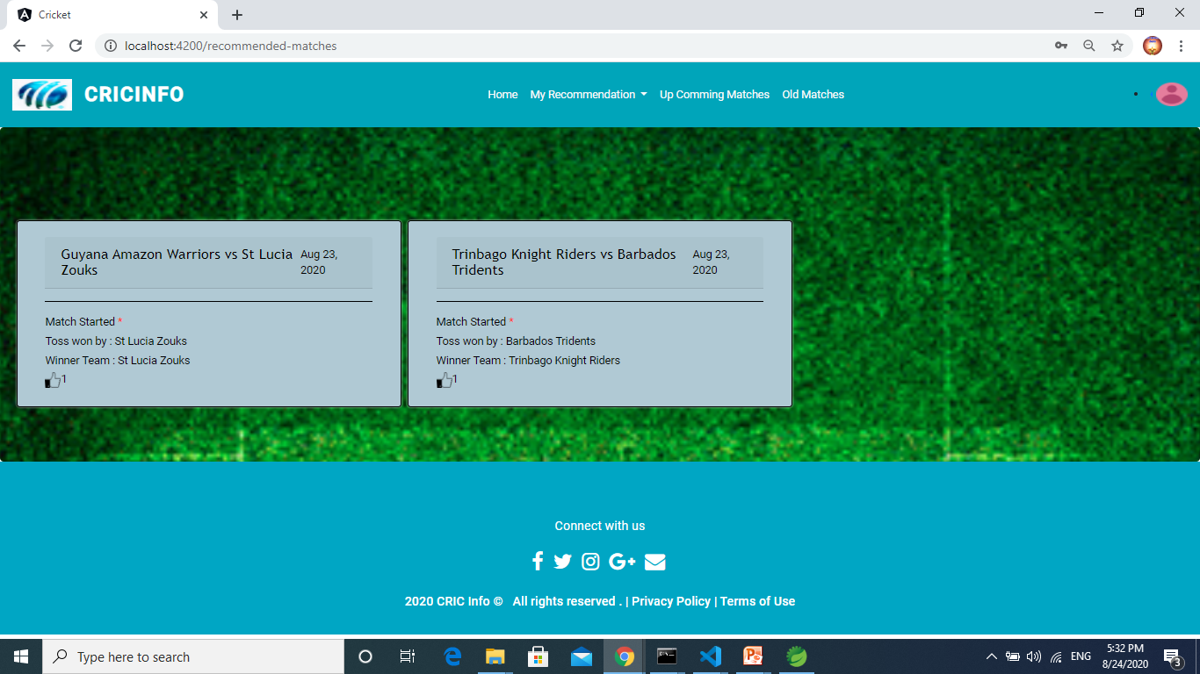
Recommended-Matches

Slide 14
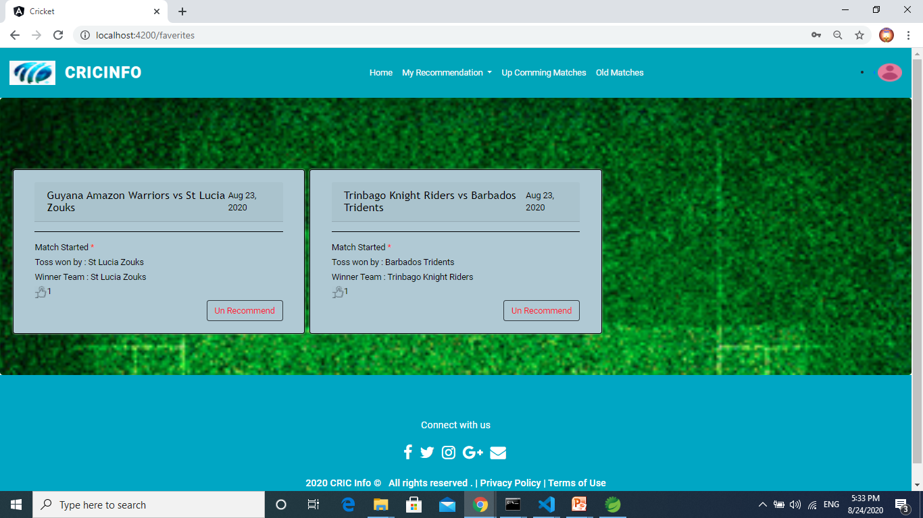
Favorite - Matches

Slide 15
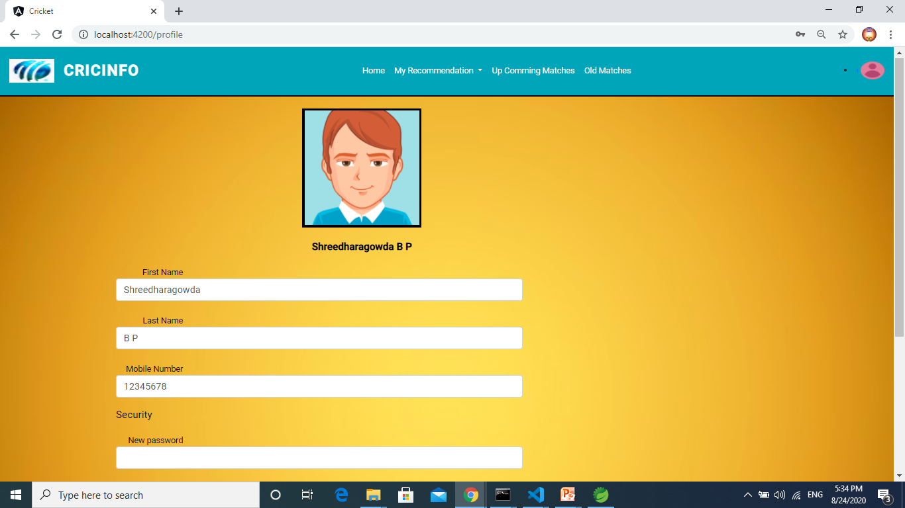
Profile-Update

Slide 16
Testing
Front-End Testing
Login e2e Testing
Register e2e Testing
Backend - Testing
CricketMatch - Controller
CricketMatch - Service
CricketMatch - Repository

Slide 17
Conclusion
CricInfo application will provides all user needed functionality like search matches, recommend matches, un recommend matches and favorite matches and also secure user authentication.

Slide 18
Thank You

